Slide 1
CONGESTION MANAGEMENT PROCESS
2018 DRAFT
February 2019

Slide 2
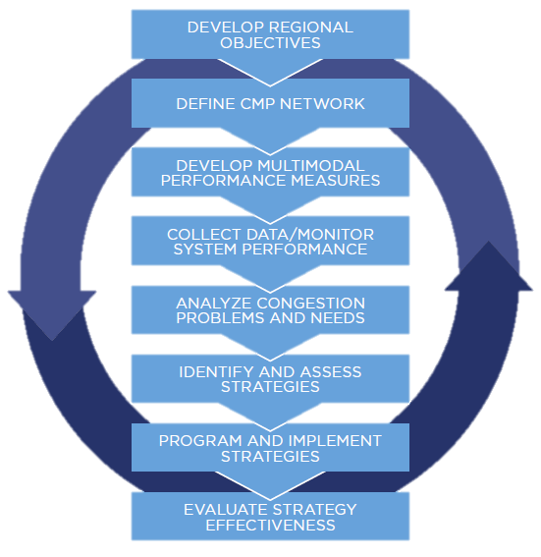
CMP Process
1
2
3
4
5
6
7
8
FHWA Congestion Management 8-step Process
Notes:
This is the 8-step CMP process recommended from FHWA. Our CMP document follows these exact steps – they are even the chapter headings.

Slide 4
Vehicular Transportation
SR 80 @ Lyons /Sansbury Rd
TPA funding fiber optic
installation at 4 corridors
Notes:
We compare the traffic counts with the intersection capacity - Typically pay for these improvements through county road program, TPA priorities, state projects.
County road program also funding a number of capacity intersection projects

Slide 5
Mass Transit
RPM implemented
in October 2018
Notes:
Transit ridership on the decline – ridesharing, gas prices, rise in vehicle ownership, teleworking

Slide 6
Non-Motorized
Notes:
SR 7 – in state resurfacing projects
Lantana Road and Okeechobee Blvd – county resurfacing projects
Lake Ave – West Palm Beach project
NE 2 (Seacrestin Delray Beach

Slide 7
Freight
Notes:
Decrease in sugar cargo.

Slide 8
Social & Environmental
Notes:
Increased the amount of Motor and Diesel Fuels consumed in Palm Beach County (taxable gallons) and divide by the most recent population estimates.

Slide 9
Current Goal
Bureau of Economic & Business Research (BEBR) 2018 Population estimates January 4, 2019 (AirQuality_2018Report.pdf)
Dept of Revenue Florida Fuel Tax, Collection Allowance, Refund, and Pollutants Tax Rates (FDORFuelTaxCollectionRefunPollutantTax_2018 .pdf) Calculations:
Rate Changes for 2018 2 B 2018 State Taxes
Inspection Fee, Ninth Cent, Local Option, Additional Local Option, and SCETS Fuel Taxes
Tax and Collection Allowance Rates by Form and Line Item
Local Option Tax Entitled and Not Entitled to Collection Allowance (Gasoline, Gasohol, and Fuel Grade Ethanol)
Pollutants Tax Rates 6 F Refund Rates
Mass Transit System Provider Credit/Refund Rate (Gasoline, Gasohol, and Fuel Grade Ethanol)
Refundable Portion of Local Option and State Comprehensive Enhanced Transportation System (SCETS) Tax.
Shared Collection Allowance Rates
Decrease in daily emissions (Census estimates 2018 with VMT / total fuel use)

Slide 10
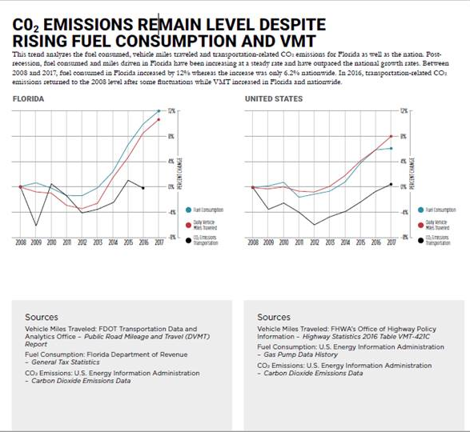
2018 FDOT Source Book

Slide 11
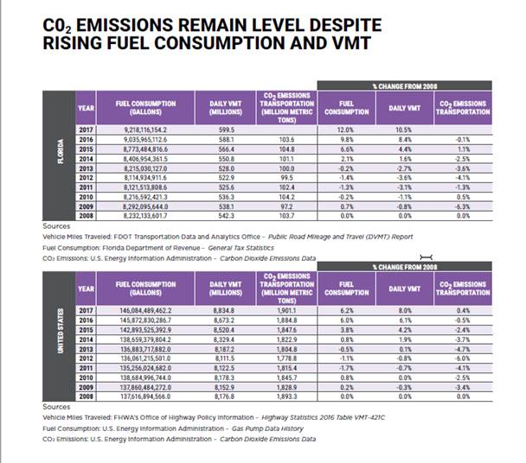

Slide 12
Future considerations
Federal performance measure requirements;
Reevaluating goals and objectives for 2045 LRTP;
Continuing research into current measures and available data sources;
Continue to summarize duration, intensity, and reliability through performance measures;
Investigate solutions through alternative modes of transportation (pedestrian, cycle, transit, etc.) through 2045 RLRTP.

